Slide 1








DIGITAL. INNOVATION. SCALE

Slide 2

Agenda
Iterator design patterns
What is Iterator Design Pattern
When to use
Examples
Questions and answers

Slide 3
What is Iterator Design Pattern
Behavioral Design Pattern
Provide a way to access the elements of an aggregate object sequentially without exposing its underlying representation.
For example:
List – The structure should allow to traverse the elements of collection without having to know it’s data structure.

Slide 4
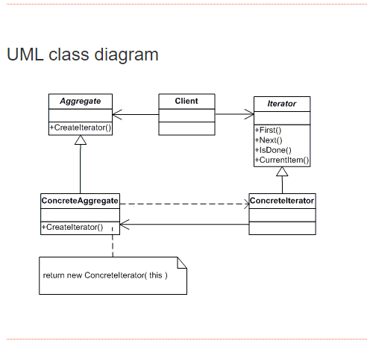
Iterator Design Pattern

Slide 5
What we need for Iterator Design Pattern
Iterator
Concrete Iterator
Aggregate
Concrete Aggregate

Slide 6
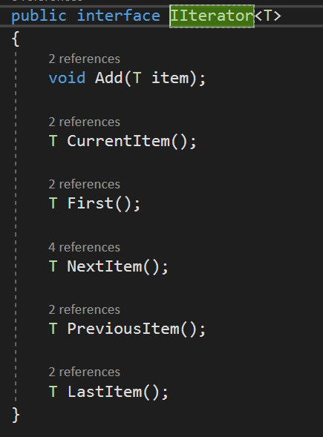
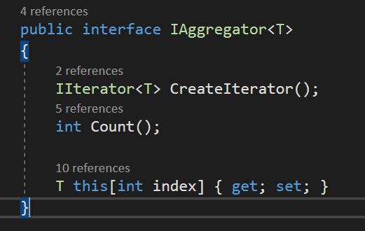
Example

Slide 7
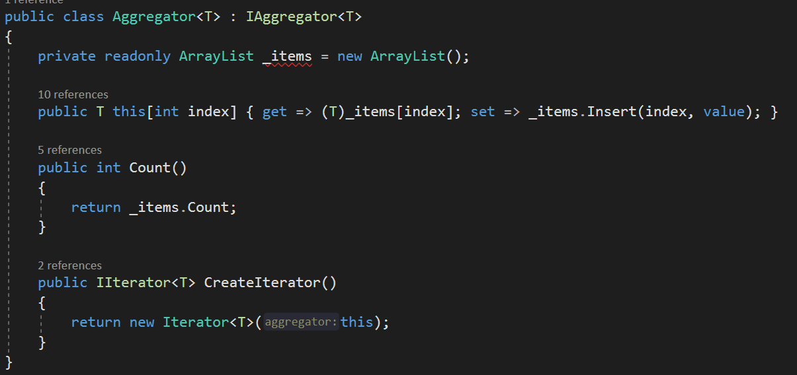
Example

Slide 8
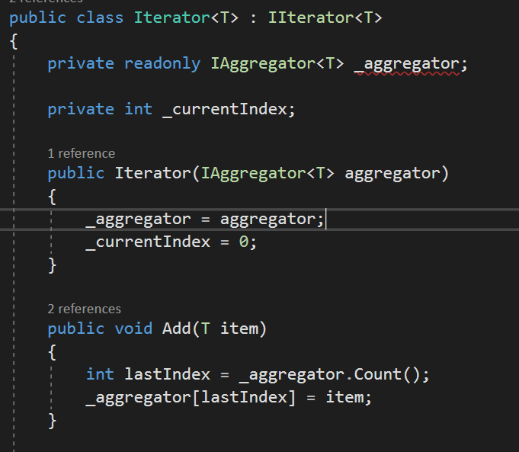
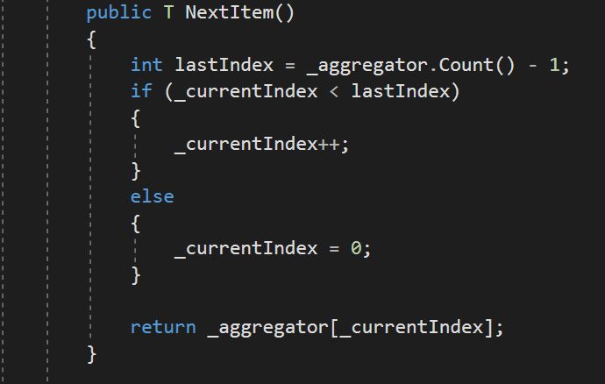
Example

Slide 9
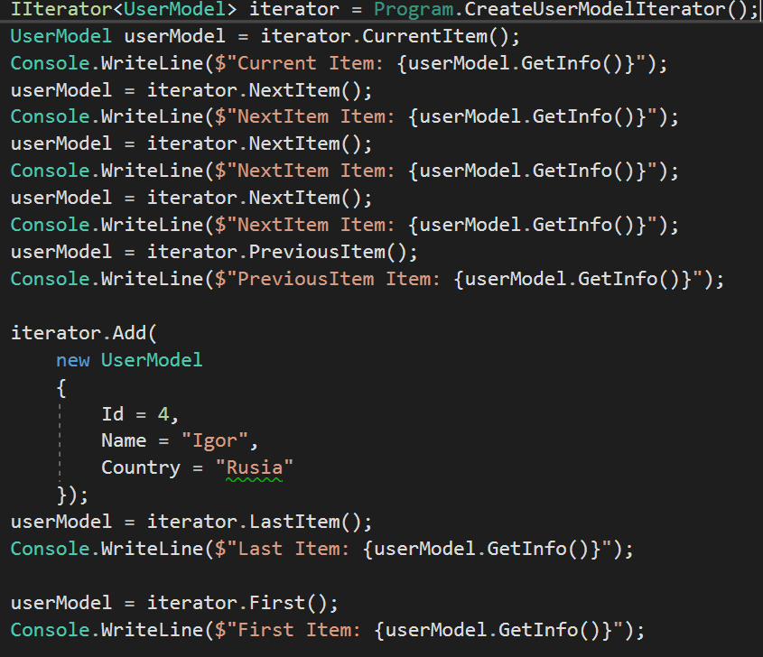
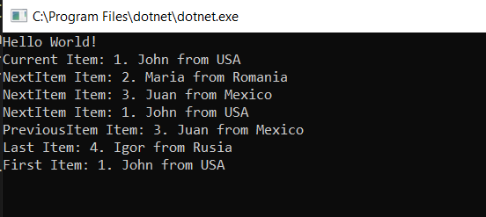
Example

Slide 10
Questions

Slide 11
References
GOF – Design Patterns - http://www.w3sdesign.com/GoF_Design_Patterns_Reference0100.pdf
Dotfactory - https://www.dofactory.com/net/design-patterns
Code example -https://gitlab.softvision.ro/enterprise.net/design-patterns/command

